Slide 1


Real-Time Flight Delay Prediction Using Machine Learning
An In-Depth Analysis and Model Development
By Ali El Masri
Notes:
“Hello everyone! I’m delighted to have you here today as We’re going to dive into an exciting project that blends aviation and machine learning technology—‘Real-Time Flight Delay Prediction Using Machine Learning.’ My name is Ali and over the next few minutes, I’ll walk you through how we developed a model that could change how airlines predict and manage flight delays."

Slide 2
Introduction
Flight delays significantly impact airline operations and customer satisfaction.
This study aims to develop a robust machine learning model capable of predicting the duration of flight delays using both historical and real-time data.
Objective: Help Airlines run smoother operations.
Notes:
"Flight delays are more than just an inconvenience—they’re a major headache for both airlines and passengers. Imagine the ripple effect of a single delayed flight on a busy day; it’s a logistical nightmare. In this project, we aimed to create a solution using machine learning to predict these delays before they even happen. We focused our efforts on JFK Airport, using a combination of historical flight data and real-time updates to build a model that could provide timely and accurate delay predictions. The goal? To help airlines run smoother operations and keep passengers happier."

Slide 3
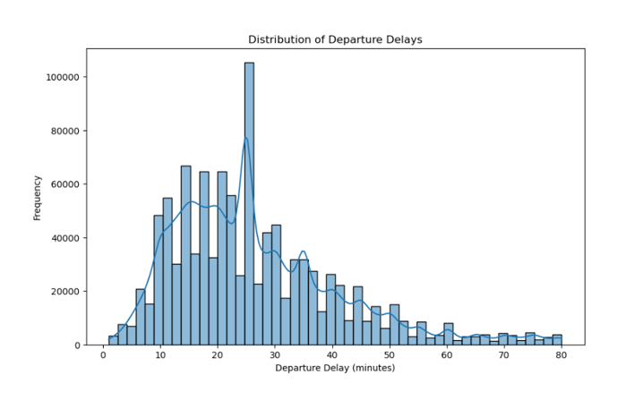
Data Sources and Preparation
Data was sourced from the Aviation Edge API and Open-Weather API.
Challenges included inconsistent coverage and noise introduction from additional data sources.
Final dataset included 22 relevant features after cleaning and preprocessing.
Notes:
"Data is the backbone of any machine learning model, and in our case, we relied on two key sources: the Aviation Edge API for detailed flight data and the Open-Weather API for real-time weather information. However, working with data wasn’t without its challenges. We encountered inconsistencies, particularly when trying to merge data from different sources. After some trial and error, we decided to streamline our approach, focusing on the most reliable data. We ended up with 22 key features after a rigorous cleaning process, which gave us a solid foundation to build our model."

Slide 4
Modeling Approach
An ensemble model combining XGBoost and Random Forest was selected for its superior performance.
Preprocessing techniques included Cyclical Encoding, Label Encoding, One-Hot Encoding, and Standard Scaling.
Model training was done using GridSearchCV for hyperparameter tuning.
Notes:
"When it came to choosing a model, we knew it had to be something robust, given the complexity of predicting flight delays. After experimenting with a few options, we landed on an ensemble model that combines XGBoost and Random Forest. Think of it as getting the best of both worlds—XGBoost is great at handling complex patterns, while Random Forest adds stability and reduces the chances of our model overfitting. We also put a lot of thought into how we prepared the data—using techniques like cyclical encoding for time-based features to make sure we captured all the nuances in the data. And with the help of GridSearchCV, we fine-tuned the model to get the best possible performance."

Slide 5
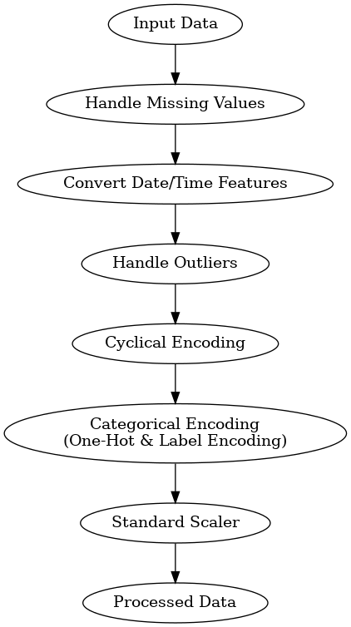
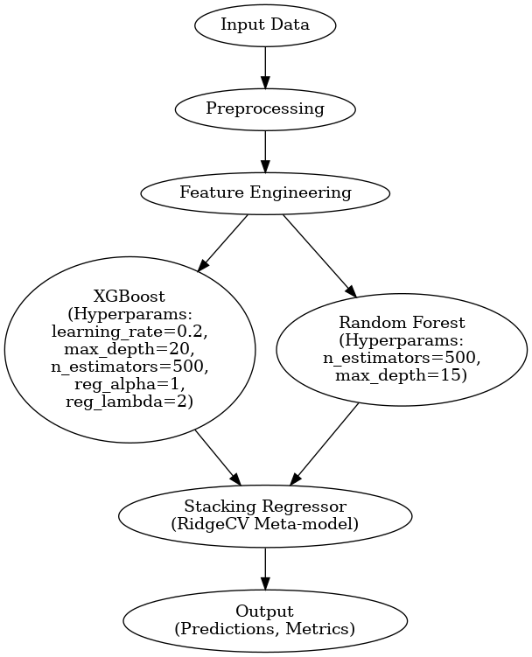
Model Architecture Diagram
Notes:
"This slide gives you a bird’s-eye view of how our model is structured. Starting with data preprocessing, where we clean and prepare the data, all the way through to real-time predictions. Each step is crucial in ensuring that when we make a prediction, it’s as accurate as possible. The ensemble model sits at the heart of this process, working hard to deliver predictions that airlines can rely on. We can observe the hyperparameters used for both xgboost and the random forest, stacked to combine their prediction while adding l2 regularization to prevent overfitting"

Slide 6

Model Performance
The final model performance metrics will include MAE, MSE, and RMSE.
Metric | Value
Mean Absolute Error (MAE) | 1.72 minutes
Mean Squared Error (MSE) | 13.54
Root Mean Squared Error (RMSE) | 3.68 minutes
Notes:
"Now, let’s talk numbers—how well did our model actually perform? We measured its accuracy using a few key metrics, like Mean Absolute Error, or MAE, which tells us how close our predictions were to the actual delay times. On average, our model was off by just 1.72 minutes, which is pretty impressive in the world of flight delays. We also looked at the Root Mean Squared Error, which came in at 3.68 minutes. This means most of our predictions are within this range, making our model a reliable tool for real-time predictions.“

Slide 7
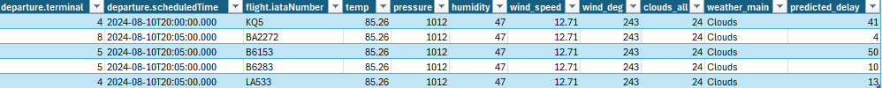
Real-Time Prediction Pipeline
A dedicated pipeline was developed to handle real-time data processing and prediction.
The pipeline integrates live data from the Aviation Edge and Open-Weather APIs.
Trimmed Down Example Data frame
Notes:
"What’s really exciting about our model is its ability to make real-time predictions. We developed a pipeline that continuously pulls in the latest data from the Aviation Edge and Open-Weather APIs. This pipeline mirrors the same steps we used during training, so the model gets the freshest data possible and can make accurate predictions on the fly—pun intended. This system can be seamlessly integrated into an airline's operations, helping them stay one step ahead of delays."

Slide 8
Conclusion
Future work will focus on refining the model, incorporating additional data sources, and testing its generalizability to other airports.
The ensemble model combining XGBoost and Random Forest proved effective in handling the complexity of the data.
Notes:
"In wrapping up, I’d say we’re really proud of what we’ve accomplished with this project. We set out to build a machine learning model that could predict flight delays in real time, and we succeeded. The combination of XGBoost and Random Forest turned out to be a winning strategy. While there’s always room for improvement, especially in terms of expanding the model to other airports, we’ve laid a strong foundation that could significantly benefit airlines and passengers alike.“
"Looking ahead, we’re eager to refine the model further. There’s potential to incorporate even more data sources, which could help make our predictions even more accurate. We also plan to test how well this model can be applied to other airports beyond JFK. The more versatile our model, the more impact it can have across the industry."

